Slide 1
Basics of broadcasting -an Introduction to digital TV Technology
By Ravi Kumar (22-Jan-2012)

Slide 2
Contents
Digital Television
Benefits of Digital Television
Digital TV Standards
Digital TV Transmission Setup
Encoder
Multiplexer
Conditional access (CA)
Error correction and error prevention
Modulating the signal

Slide 3
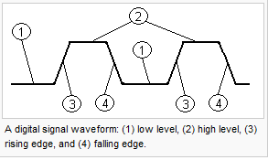
Digital Television
Digital Television (DTV) is the transmission of audio and video by digital signals, in contrast to the analog signals used by analog TV. Many countries are replacing analog television broadcast with digital television to allow other uses of the television radio spectrum.
Digital Signal is a physical signal that is a representation of a sequence of discrete values (a quantified discrete-time signal), for example of an arbitrary bit stream, or of a digitized (sampled and analog-to-digital converted) analog signal.
The term digital signal can refer to,
A continuous-time waveform signal used in any form of digital communication.
A signal that is generated by means of a digital modulation method, produced by a modem is considered as a digital signal.

Slide 4
Benefits of Digital Television
Increased channel capacity such that more channels can be offered within a fixed amount of broadcast bandwidth.
Increased programming options including interactivity and Video on Demand (VoD)
Improved picture quality even with a standard-definition signal.
Improved security to prevent unauthorized persons from receiving services.

Slide 5
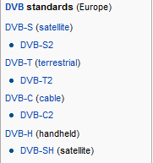


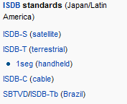

Digital TV Standards

Slide 6
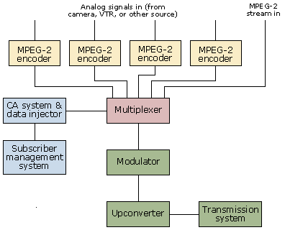
Digital TV Transmission Setup
The components that make up a typical broadcast system.
This equipment is normally all connected together using high-speed connections like SDI (Serial Digital Interface) or ASI (Asynchronous Serial Interface) which are standard in the TV filed.

Slide 7
Encoder
Encoder: A device used to change a signal (bit stream) or data into a code.
An audio encoder may be capable of capturing, compressing and converting audio.
A video encoder may be capable of capturing, compressing and converting audio/video.
The encoder is used to take an analog signal and convert it to MPEG-2.
This is more commonly used in live shows – for other shows we may have a selection of pre-encoded MPEG streams that we can play out from a dedicated play out system.
An encoder can generate two types of MPEG stream.
Constant bit-rate MPEG streams always have the same bit-rate, no matter what the complexity of the scene they contain.
If the signal is too complex to be coded at the specified bit-rate, the quality of the encoding will be reduced.
If the scene takes less data to code than the specified bit-rate, it will be stuffed with null packets until the constant bit-rate is reached.
This makes later parts of the processing easier, because the fact the bit-rate does not change makes things easier to predict later, but it does waste bandwidth.

Slide 8
Encoder
Variable bit-rate MPEG streams: In this case, the bit-rate can be adjusted dynamically, as more or less bandwidth is needed to encode the images with a given picture quality.
Since some scenes takes significantly more bandwidth to encode than others, this lets the picture quality be maintained throughout a show while the bandwidth changes.
The fact that the bit-rate of the stream can change doesn’t mean that it will reach higher levels than a constant bit-rate encoding of the same stream.
The operator can usually set the maximum bit-rate that the encoder can use, and the encoder will reduce the quality of the encoded output.
Most broadcasters today use variable bit-rate encoding because it offers better quality while using lower bandwidth. In particular, variable bit-rate encoding lets us make maximum use of the available bandwidth at the multiplexing stage.

Slide 9
Multiplexer
One MPEG stream on its own is not much use to us as a TV broadcast. Even several MPEG streams are not very useful, because we have no way of associating them with each other.
We really need a single stream containing all the MPEG streams needed for a single service or multiple services, and that single stream is called as ‘Transport Stream’
The multiplexer takes one or more MPEG streams and converts them into a single transport stream.
Multiplexing is sending multiple signals or streams of information on a carrier at the same time in the form of a single, complex signal and then recovering the separate signals at the receiving end.
In digital transmission, signals are commonly multiplexed using time-division multiplexing (TMD), in which the multiple signals are carried over the same channel in alternating time slots.
The input streams may be individual elementary streams, transport streams or even raw MPEG data.
Each transport stream typically has a fixed bandwidth available to it, which depends on the transmission medium and the way the transmission network is set up.

Slide 10
Multiplexer
One of the jobs of the multiplexer is to fit a set of services in to the available bandwidth.
The easy way of doing this is to use constant bit-rate MPEG streams, because then the operator knows exactly how much bandwidth each stream will take, and setting up the multiplexer is easy.
Some streams may be using less than their share of the bandwidth, while others may need to reduce the picture quality in order to fit in their allocated share.
The way around to this is to use variable bit-rate MPEG streams and a technique known as statistical multiplexing.
This system takes advantage of the statistical properties of the multiplexed stream when compared to the properties of the several independent streams.
While the bit-rate of each individual stream can vary significantly, these variations are smoothed out when we consider 10 or 15 streams multiplexed together.

Slide 11
Multiplexer
Some streams will need a higher bit-rate than average at that time, but others will probably need less than average.
By maintaining a separate buffer model for each stream, the multiplexer can decide how to order packets in the most efficient way, while making sure that there are no glitches in any of the services.
At some points, the streams being multiplexed may have a bit-rate that is higher than the available bandwidth. A statistical multiplexer will use another one of the statistical features on MPEG streams to handle this situation.
Since most MPEG streams only reach their peak bandwidths at fairly wide intervals for fairly short periods, delaying one or more of the streams will move the peak to a point where the bandwidth is available to accommodate it.
This is another reason to maintain a buffer model for each stream – to ensure that these peaks are not moved to a point where they would cause a glitch in the service.

Slide 12
Conditional Access (CA)
Since we may not want to give our content away for free, we need some way of encrypting our services. This is handled by the conditional access (CA) system.
The algorithm that is used for this is proprietary to each Vendor.
In a DVB system, scrambling can work at either the level of the entire transport stream or on the level of individual elementary streams.
In the case of scrambled elementary streams, not all of the data is actually scrambled – the packet headers are left unscrambled so that decoders can work out their contents and handle them correctly.
In the case of transport stream scrambling, only the headers of the transport packets are left unencrypted – everything else is scrambled.

Slide 13
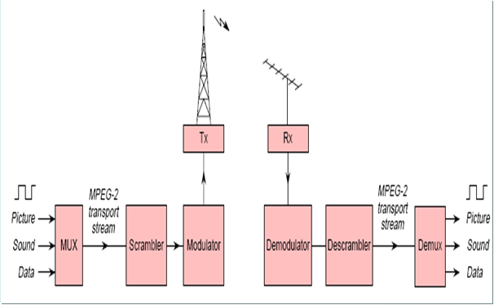
Basic Scrambling System

Slide 14
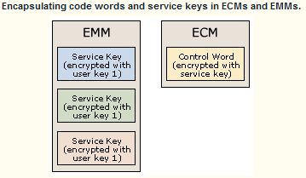
Conditional Access (CA)
As well as an encrypting the data that’s supposed to be encrypted, the CA system adds two types of data to the stream.
These are known as CA messages, and consist of Entitlement Control Messages (ECM) and Entitlement Management Messages (EMM).
These control the ability of individual or group of users to watch scrambled content.
The scrambling process relies on three pieces of information:
The Control Word
The Service Key
The User Key

Slide 15
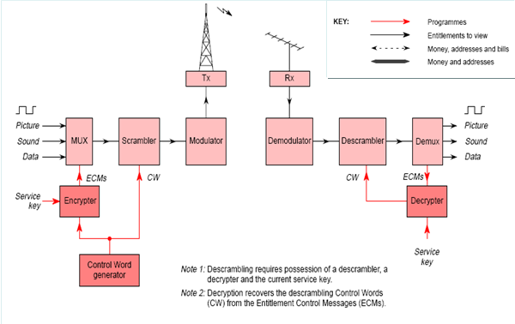
Scrambling with Encrypted Control Words

Slide 16
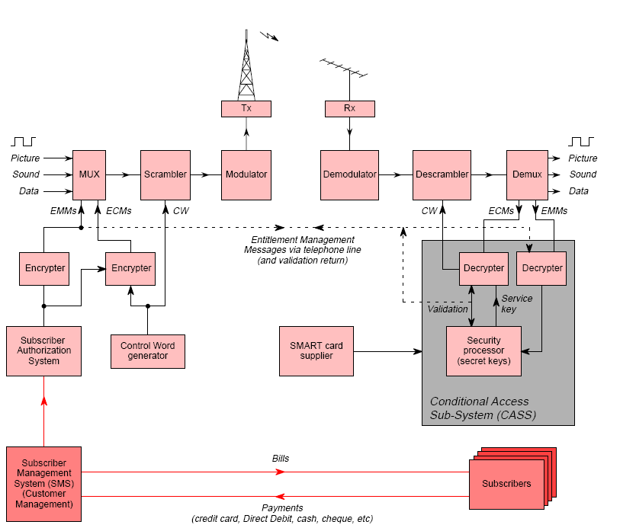
Scrambling system with encrypted CW, EMM & SMS

Slide 17
Conditional Access (CA)
The control word is encrypted using the service key, providing the first level of scrambling.
This service key may be common to a group of users, and typically each encrypted service will have one service key.
This encrypted control word is broadcast in an ECM approximately once every 2 sec and is what the decoder actually needs to descramble a service.
We have to make sure that only authorized users can decrypt the control word, to do this the service key is itself encrypted using the user key.
Each user key is unique to a single user, and so the service key must be encrypted with the user key for each user that is authorized to view the content.
Once we have encrypted the service, it is broadcast as part of an EMM.
Each EMM is broadcast approximately every 10 seconds.

Slide 18
Conditional Access (CA)
When a receiver gets a CA message, it’s passed to CA system.
In case of an EMM, the receiver will check whether the EMM is intended to that receiver(usually by checking the CA serial number or smart card number), and if it is, it will use its copy of the user key to decrypt the service key.
The service key is then used to decrypt any ECMs that are received for that service and recover the control word
Once the receiver has the correct control word, it can use this to descramble the content.
Sometimes EMMs may be used for other CA-related tasks besides decrypting service keys, such as controlling the pairing of a smart card and STB so that the smart card will work correctly in that receiver.

Slide 19
Conditional Access (CA)
Subscriber Authorization System (SAS) is the centre responsible for organizing , sequencing and delivering EMM and ECM data streams under direction from SMS.
In order to generate the EMMs correctly, the CA system needs to know some information about which subscribers are entitled to watch which shows.
The Subscriber Management System (SMS) is used to set which channels an individual subscriber can watch.
This is a large database of all the subscribers that is connected to the billing system and to the CA system, and is used to control the CA system and decide which entitlements should be generated for which users.
The SMS and CA system are usually part of the same package from the CA vendor.
The ECMs and EMMs are broadcast as part of the service.
The PIDs for the CA data are listed in the Conditional Access Table (CAT), and different PIDs can be used for ECMs and EMMs.
This makes it easier for remultiplexing, where some of the CA data (ECMs) may be kept, while other data (EMMs) may be replaced.

Slide 20
Conditional Access (CA)
NDS and Nagravision are the two most common CA systems.
DVB systems can offer pluggable encryption modules using the DVB common interface (CI), which uses a PCMCIA card to contain the encryption hardware and software.
This means that the user can switch encryption systems without having to replace the entire STB.
Some companies are not convinced of the security of the DVB CI system, and so not all CA systems are available as CI modules.
ATSC uses a similar, slightly more secure, mechanism called the POD (Point of Deployment) module known as CableCARD in Open Cable systems.
These are more widely deployed in US markets and all OCAP receivers will include a CableCARD slot.

Slide 21
Error correction and error prevention
Before we can transmit our signal we need to make sure that it will be received correctly. This means some way of identifying and correcting errors in the stream.
To do this we add some extra error correction data to the MPEG packets, in order to allow us to correct data.
The most common requirement in DTV systems is for an MPEG stream to be quasi-error free (QEF), which means a bit error rate of approximately 1x10⁻¹⁰, or one erroneous bit every 1 hr of video for a 30 Mbits/sec stream.
Forward Error Correction (FEC) is the process which is used to correct the errors in real-time.
Different transmission mechanisms (cable, satellite or terrestrial) all have different characteristics including different noise levels.
A satellite signal for instance can have a lot of errors introduced by conditions in the atmosphere.
A terrestrial signal may have errors introduced by reflections from buildings or by the receiving aerial not being aligned correctly.

Slide 22
Error correction and error prevention
These different conditions mean that very efficient error correction mechanisms are needed.
DVB and ATSC systems all use Reed-Solomon encoding to add a first layer of protection.
This adds a number of parity bytes to each packet. This 16 parity bytes are added to a 188-byte packet, which means that an 8-byte error can be corrected. Large errors can be detected but not corrected.
Once this is done a further layer or error correction coding is added to improve things still further.
Common coding mechanisms at this stage are trellis coding and viterbi coding.
These exploit the fact that data is not sent one bit at a time, but is instead sent as ‘symbols’ that can carry several bits of data.

Slide 23
Error correction and error prevention
In trellis coding, symbols are grouped together to form ‘trellises’.
For a group of three symbols, a modulation scheme that stores eight bits per symbol can store 512 separate values.
By using a subset of these as ‘valid’ values, the network operator can introduce some extra redundancy into the signal.
The effect of this is that each symbol may carry fewer bits of data, but for every group of three symbols, it is possible to correct one erroneous symbol by choosing the value for that symbol that gives a valid trellis.
This is the approach used by US digital terrestrial systems.
DVB systems use Viterbi coding instead, which is a modification of trellis coding that uses a slightly different algorithm to find the best matching trellis.

Slide 24
Error correction and error prevention
To strengthen the error correction, another technique called interleaving may be added.
This helps to avoid situations where a burst of noise (e.g. a lightning strike causing electrical interference) can corrupt data past the point where FEC can fix it.
After the data has FEC added, but before it is transmitted, the data is written to a RAM buffer and then read out in a different order.
For instance, if we assume that our RAM buffer is a two-dimensional array with ten rows and ten columns, the data may be written to the buffer starting at row 1 and working down to row 10, then read from starting at the top of column 10 and working back to column 1.
This means that bytes from the same packet (which will share error correction) are spread over a longer transmission period and are less vulnerable to burst noise.

Slide 25
Error correction and error prevention
At the receiver, the process is reversed and the original order of the bytes can be restored.
The interleaving scheme described here is not the only possible one, and other techniques will often be used instead.
Once we have added error correction, we need to do one more thing before it can be prepared for transmission.
If the digital bitstream contains a large run of 1’s, then there will be a current flowing in the transmission and reception equipment.
So some randomization is needed to make sure that there is never a long run of 1’s or 0’s in the bitstream and to disperse the energy in the signal across all of its bandwidth.
To do this a simple randomizer is used. The process is symmetrical, so the same hardware is used to de-randomize the signal in the receiver.

Slide 26
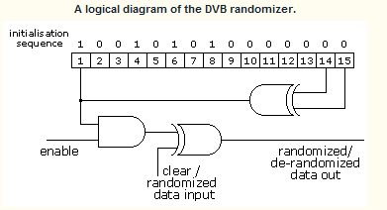
Error correction and error prevention
Every eight transport packets, the randomizer is reset and its register is loaded with the bit sequence 100101010000000.
The randomizer and the de-randomizer must both reset themselves at the same point in the stream, or the input can’t be recreated. This is done using the sync bytes from the transport packets.
These are not scrambled, so the start of a packet can always be identified, and at every eighth packet, the value of the sync byte is inverted.
This is the signal for the de-randomizer to reset itself, making sure that both the randomizer and the de-randomizer are synchronized correctly.
By doing this, we make sure that the energy is dispersed across the signal spectrum.
DVB requires a transmitter and receiver do this before transmitting the signal.
The randomizer and its inputs are standardized by DVB in the standards for satellite (EN 300 421), cable (EN 300 429) and terrestrial transmission (EN 300 744).
ATSC defines its own randomizer.

Slide 27
Modulating the signal
Now we have a digital stream that is almost ready for broadcast.
We can’t directly broadcast digital data – first we have to modulate it – convert it to an analog signal so that we can broadcast it using radio signals or electrical voltages in a cable.
As we have already seen, each of the different transmission mechanism has different characteristics, and different strengths and limitations. So each type of signal uses a different modulation scheme.
The modulation scheme is just the way of converting digital information into an analog signal so that it can be transmitted.
The table below describes which modulation scheme is used by each of the transmission mechanisms in a DVB environment.
Transmission Mechanism | Modulation
Satellite | QPSK
Cable | QAM
Terrestrial | OFDM

Slide 28
Modulating the signal
Cable and satellite use a similar modulation scheme (it’s actually the same scheme, with different parameters).
The main difference is that satellite signals are more prone to errors and so use a less efficient way of sending the data that provides a bigger difference between symbols, making correct demodulation easier.
Terrestrial broadcasts use a different scheme in order to provide a much stronger resistance to errors caused by reflected signals.
The USA uses different schemes for modulation as shown in below table.
Transmission Mechanism | Modulation
Satellite | QPSK
Cable | QAM
Terrestrial | 8VSB

Slide 29
Modulating the signal
Some satellite providers follow the DVB standards, while other satellite networks and many cable networks use proprietary systems such as DigiCipher II (both cable and satellite) and DSS (satellite only).
In all cases they appear to use the same modulation scheme, but details of error correction and other parameters may be different.
The modulation is carried out by a device called a modulator.
This takes the digital transport stream as an input, and produces an analog output that can be passed onto the transmission equipment.
The modulator is the last stage in the process that takes a digital input.
Typically, signals are modulated to a lower frequency than they are broadcast at.
Since the broadcast frequencies can be very high (up to 30GHz – satellite and up to 950MHz – cable signals), modulating the signals at these frequencies can be hard.
So the frequencies are modulated at a lower frequency, which is then converted to a higher frequency before transmission. This is done using an upconverter.

Slide 30
Modulating the signal
Basically, upconverter does nothing else except converting the signal from one frequency to another much higher frequency.
In this case that other frequency is the one used by the network that you are broadcasting on.
Each transport stream will be broadcast on a different frequency and so the upconverter will have different settings for each transport stream that it handles..
Once you have a modulated signal, the signal is ready for transmission.

Slide 31
Thank You

